Slide 1
NAME OF THE PROJECT Micro Credit Defaulter Project
Submitted by:
Arshi Maitra

Slide 2
Acknowledgement:
This project has been completed with the help of training documents and live classes recordings from Data Trained Education. Few helps on coding have also been taken from few data science websites like Toward Data Science, Geek for Geeks, Stack Overflow.

Slide 3
INTRODUCTION
Microfinance is a form of financial service which provides small loans and other financial services to poor and low-income households. In good times, microfinance helps families and small businesses to prosper, and at times of crisis it can help them cope and rebuild. The objective of microfinance is similar to that of microcredit; its goal is to provide financial services to help encourage entrepreneurs in impoverished nations to act on their ideas and obtain the financial tools available to do so and to eventually become self-sustainable.
Like a bank, a microfinance institution is a provider of credit. However, the size of the loans are smaller than those granted by traditional banks. These small loans are known as microcredit. The clients of an MFI are often microentrepreneurs in need of economic support to launch their business. This type of client is considered too risky by traditional banks because they cannot provide real collateral and because they tend to work in the informal sector of the economy.
Before granting the loan, MFIs analyse the clients' willingness and ability to pay. MFIs usually carry out a field survey to gather as much information as possible, not only from the future entrepreneur, but also from people who know them.
Below is the dataset available one such client that is in Telecom Industry. They are a fixed wireless telecommunications network provider. They are collaborating with an MFI to provide micro-credit on mobile balances to be paid back in 5 days. The Consumer is believed to be defaulter if he deviates from the path of paying back the loaned amount within the time duration of 5 days. For the loan amount of 5 (in Indonesian Rupiah), payback amount should be 6 (in Indonesian Rupiah), while, for the loan amount of 10 (in Indonesian Rupiah), the payback amount should be 12 (in Indonesian Rupiah).
The main goal of the project will be to predict in terms of a probability for each loan transaction, whether the customer will be paying back the loaned amount within 5 days of insurance of loan.

Slide 4
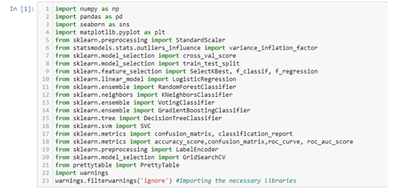
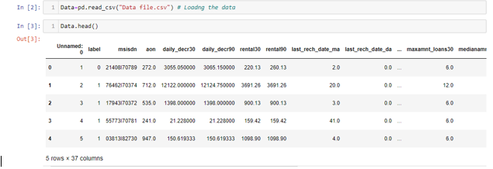
Analytical Problem Framing
Importing Libraries
Data preprocessing/Data Cleaning:

Slide 5
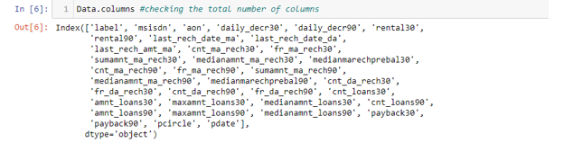
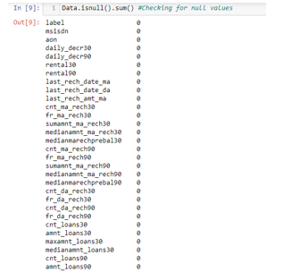
Going through the columns of the data: Checking the null values from Train and Test data:
(There is no null values in the dataset.)

Slide 6
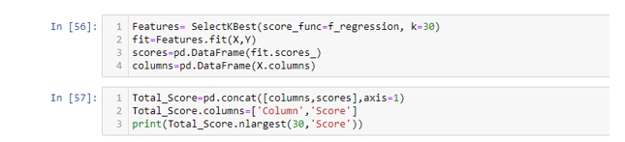
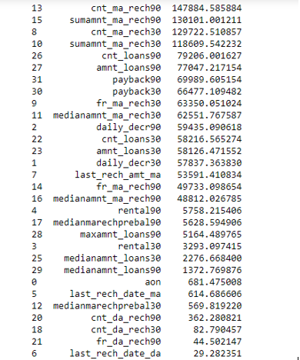
Encoding the object data types
There were 3 object data type which was the customer’s telephone number, telecom circle as well as the data. As those columns were not needed, hence they were dropped off.
Checking Scores:
Selecting K Best Feature: As we had 33 columns hence the K Best feature was used to get the 30 best column.

Slide 7
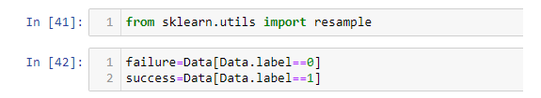

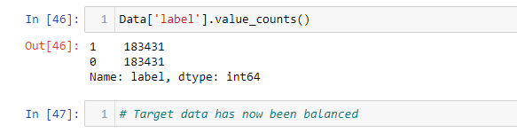
The target variable is imbalanced in nature with more data classified as a success than failure, this might make the model biased. Therefore to remove any such biasedness resampling is needed.
Importing Resample:
Upsampling the failure data:
Balanced Target Data:

Slide 8
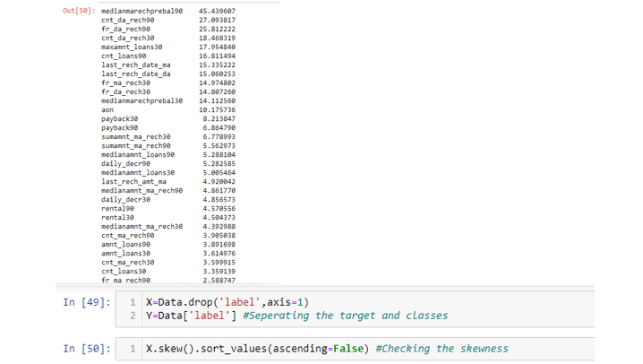
Checking Data Skewness :

Slide 9

Importing Power Transformation.
As the data is skewed it will affect the prediction score. Therefore data has to be transformed before taking any further action:

Slide 10
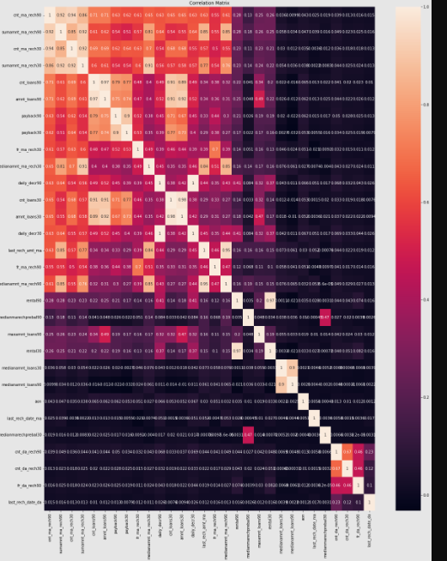
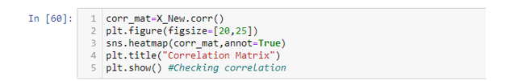
Checking Multicollinearity: 1. Heat Map:

Slide 11
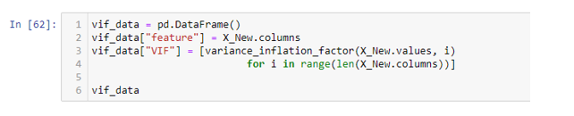
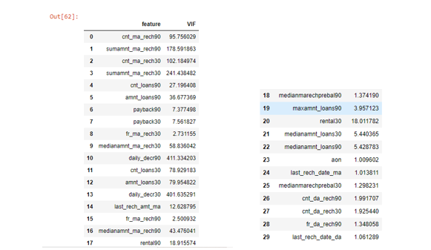
From the heat map it can be observed that there is an issue of huge multicollinearity in the data. Therefore checking the issue of multicollinearity via VIF. 2) VIF

Slide 12
Observations:
Therefore as concluded there is a huge issue of multicollinearity. Therefore few columns have been dropped off based on the following assumptions:
1. Total amount of recharge in the main account for 30 days is included in total amount of recharge for 90 days. Both these features have high correlation hence dropping one .
2. Daily recharge from main account for 30 days is included in Daily recharge from main account for 90 days. Both these features have high correlation hence dropping one .
3. Number of times main account recharge for 30 days is included in Number of times main account recharge for 90 days. Both these features have high correlation hence dropping one .
4. cnt_loans30 and amnt_loans30 are already included in cnt_loans90 and amnt_loans30. Therefore dropping one.

Slide 13
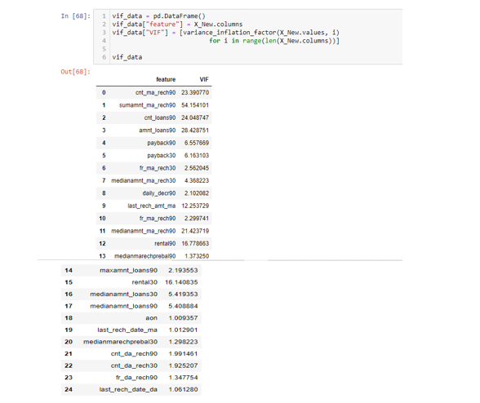
Checking the final VIF Score:
The issue of multicollinearity still remains however due to the issue of data loss, we are going ahead with the present VIF scores.

Slide 14
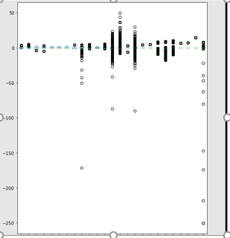

Detecting Outliers:
Importing Z Score:

Slide 15
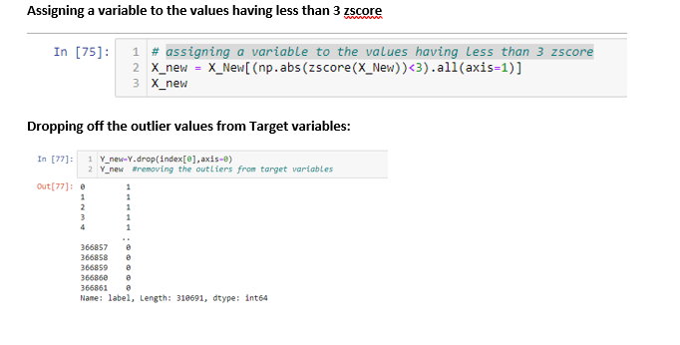
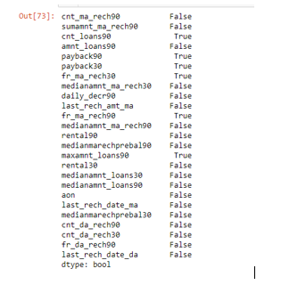
Checking those values which has got zscore less than 3:

Slide 16
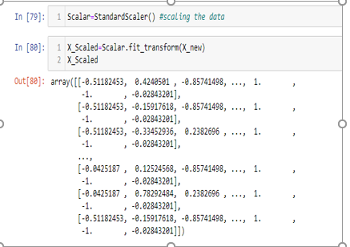
Scaling the data:

Slide 17
Model/s Development and Evaluation
(Logistic Regression, Decision Tree Classifier, Random Forest Classifier and Gradient Boosting Classifier)

Slide 18
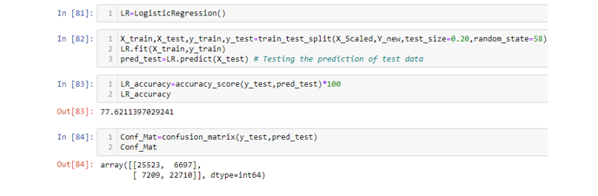
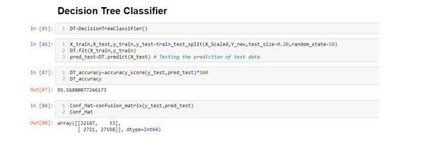
Logistic Regression: 77%
Decision Tree Classifier: 95.56%

Slide 19
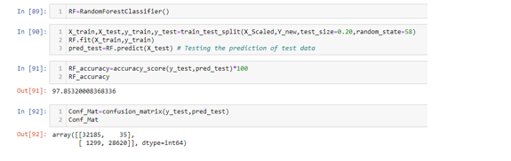
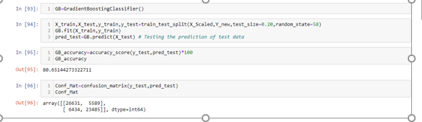
Random Forest Classifier:97.85%
Gradient Boosting Classifier:80.65%

Slide 20
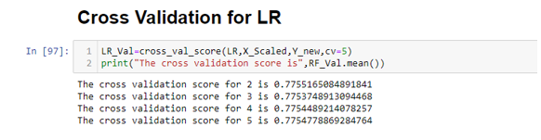
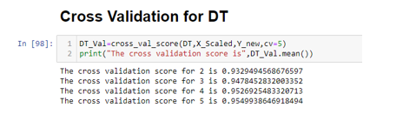
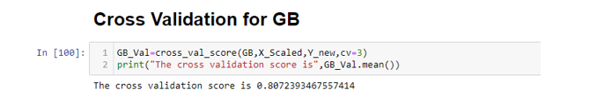
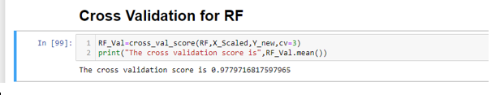
After getting the accuracy scores for all the models, it needs to be checked whether any one of them are overfitted, hence cross validation technique has been used.
Cross Validation for DT
Cross Validation for LR
Cross Validation for RF
Cross Validation for GB

Slide 21
As none of the models are overfitted, and based on the r squared score and cross validation scores, As none of the models are overfitted, and based on the accuracy score and cross validation scores, Random Forest Classifier model is best for this dataset.

Slide 22
Conclusion

Slide 23
Key Findings: This is a dataset which is filled with outliers however following points can be concluded: A customer is ready to spent around 2,65,926 amount in a month for their recharge also there are people who have not recharged their account over a month. In a month an account has been recharged over 200 times as well it has not been recharged once in a month. The highest amount recharged in a period of 90 days is 9,00,000. The top 10 points are more important to check whether a customer can successfully pay back the loan amount: Number of times main account got recharged in last 90 days Total amount of recharge in main account over last 90 days Number of times main account got recharged in last 30 days Total amount of recharge in main account over last 30 days Number of loans taken by user in last 90 days Total amount of loans taken by user in last 90 days Average payback time in days over last 90 days Average payback time in days over last 30 days Frequency of main account recharged in last 30 days Median of amount of recharges done in main account over last 30 days at user level

